Slide 1
Bubble of Most viewed links related to the current article.

Slide 2
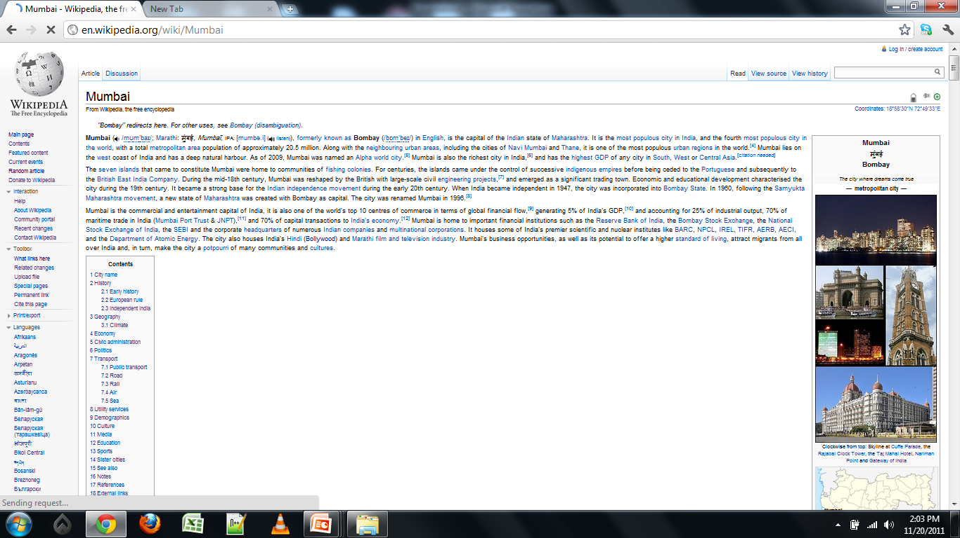
Area for the Related Tags Cloud

