Slide 1
Clicking on this link, we get any random article out of millions of articles.

Slide 2
Clicking on this link, we get any random article out of the pages that link to the current page.
Related Random Article

Slide 3
So by clicking on this link, we get a random page, out of any page that links to Mumbai.

Slide 4
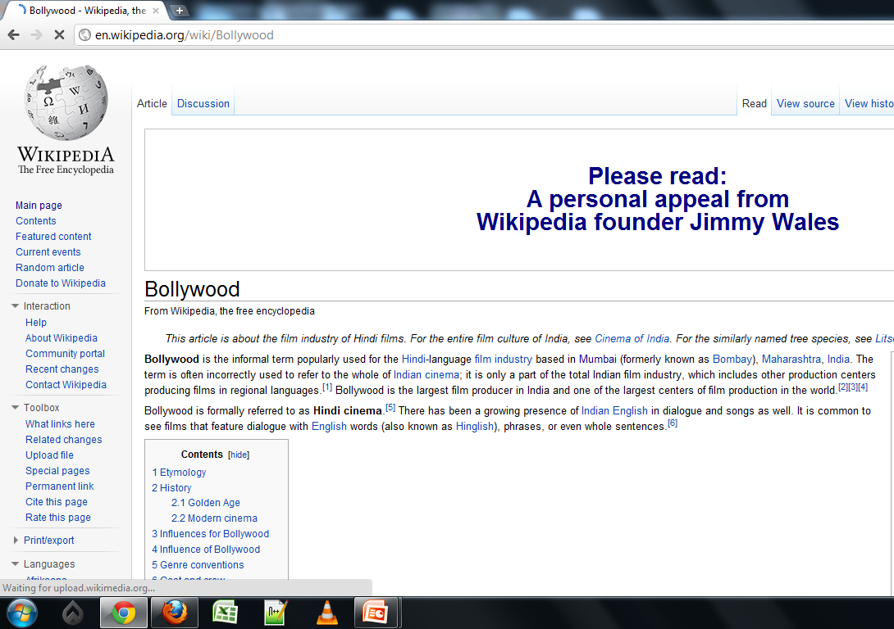
Say, for example – Bollywood.

Slide 5
This will be useful to the people who want to know about anything that is related to Mumbai.

