Slide 1
Lexemes in Wikidata
WikidataCon 2019, Berlin
Arthur Smith & Alicia Fagerving

Slide 2
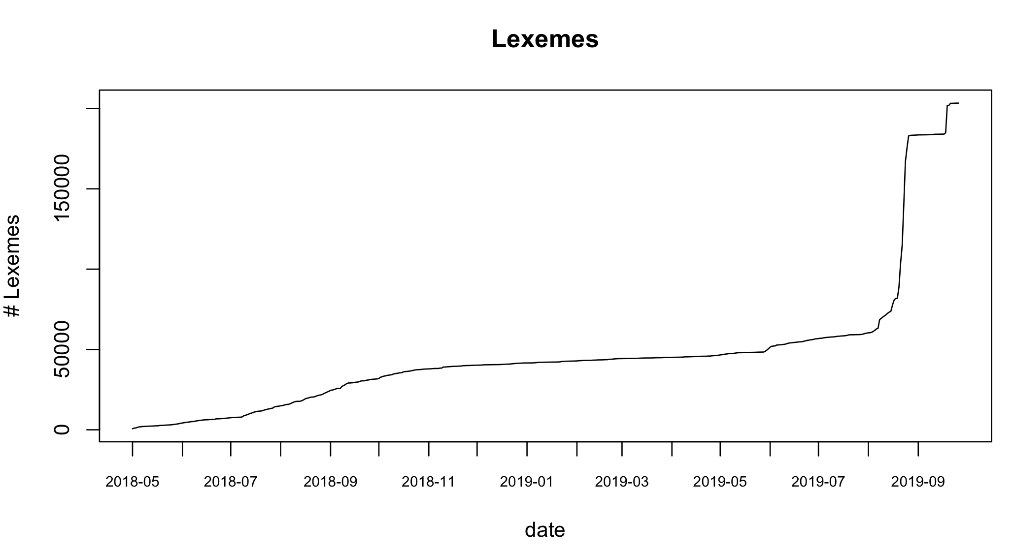

Slide 3
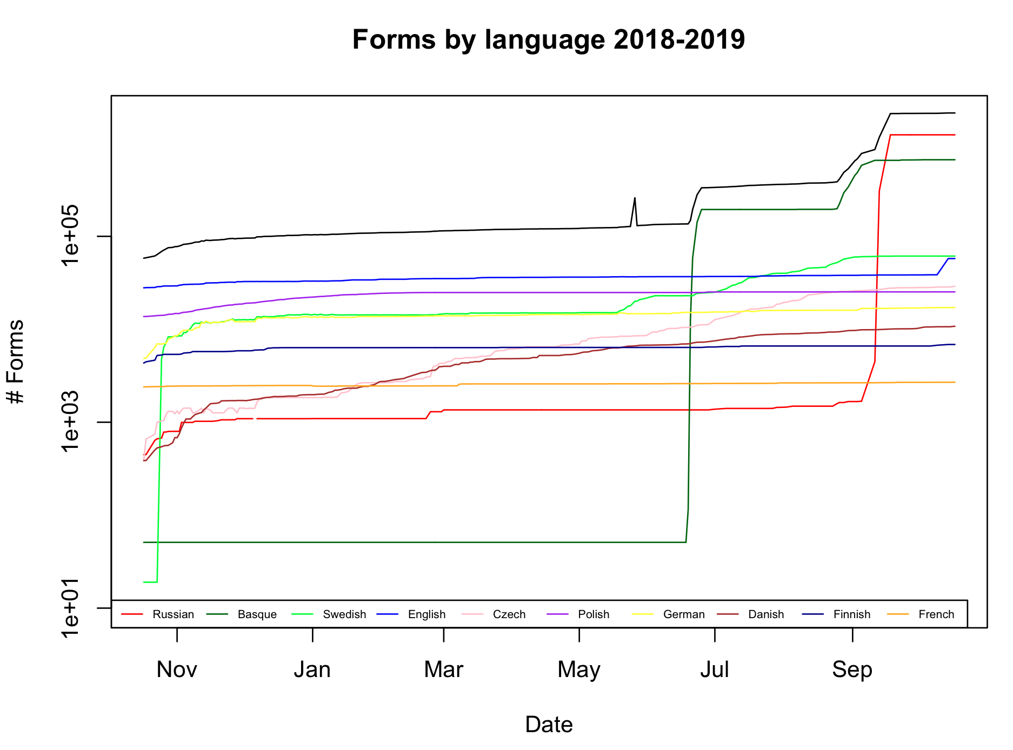

Slide 4
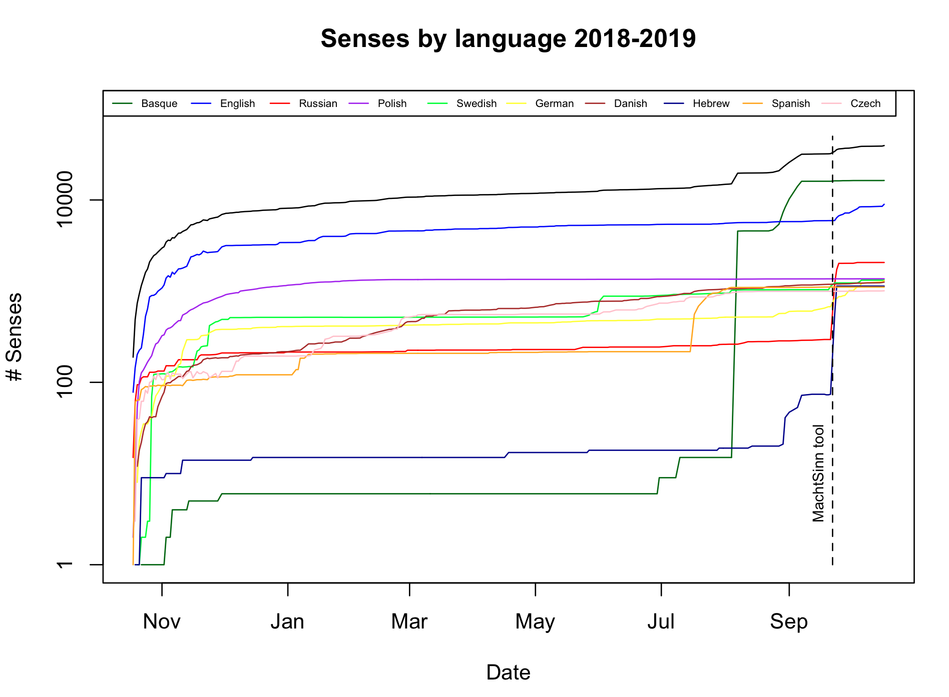

Slide 5
Common properties directly on lexemes
P5911 – “inflection class” (over 200,000 times)
P5185 – “grammatical gender” (over 100,000)
P1552 – “has quality” (over 100,000) – generally Q51927539 (inanimate) or Q51927507 (animate)
P5187 – “word stem” (73702)
P6838 – “Elhuyar Dictionary ID” (for Basque - 10280)
P5238 – “combines” (4646)
P31 – “instance of” (4485)
P5831 – “usage example” (3531)
P5191 – “derived from” (2935)

Slide 6
Common properties on forms
Varies greatly by language!
Very few on Basque lexeme forms
P7243 – “pronunciation” (ru)
P5279 – “hyphenation” (ru, cz)
P898 – “IPA transcription” (cz, en, ru)
P443 – “pronunciation audio” (cz, en, ru, sv)
P6712 – “precedes word-initial” (en)
P2440 – “transliteration” (ru)

Slide 7
Common properties on senses
P5137 “item for this sense” (15637 times)
P5972 “translation” (2322)
P18 “image” (1367)
P5973 “synonym” (983)
P31 “instance of” (795)
P6271 “demonym of” (774)
P5974 “antonym” (178)
P5323 “attested in” (88)
P5831 “usage example” (73)
P6191 “language style” (68)
P5185 “grammatical gender” (26)

Slide 8
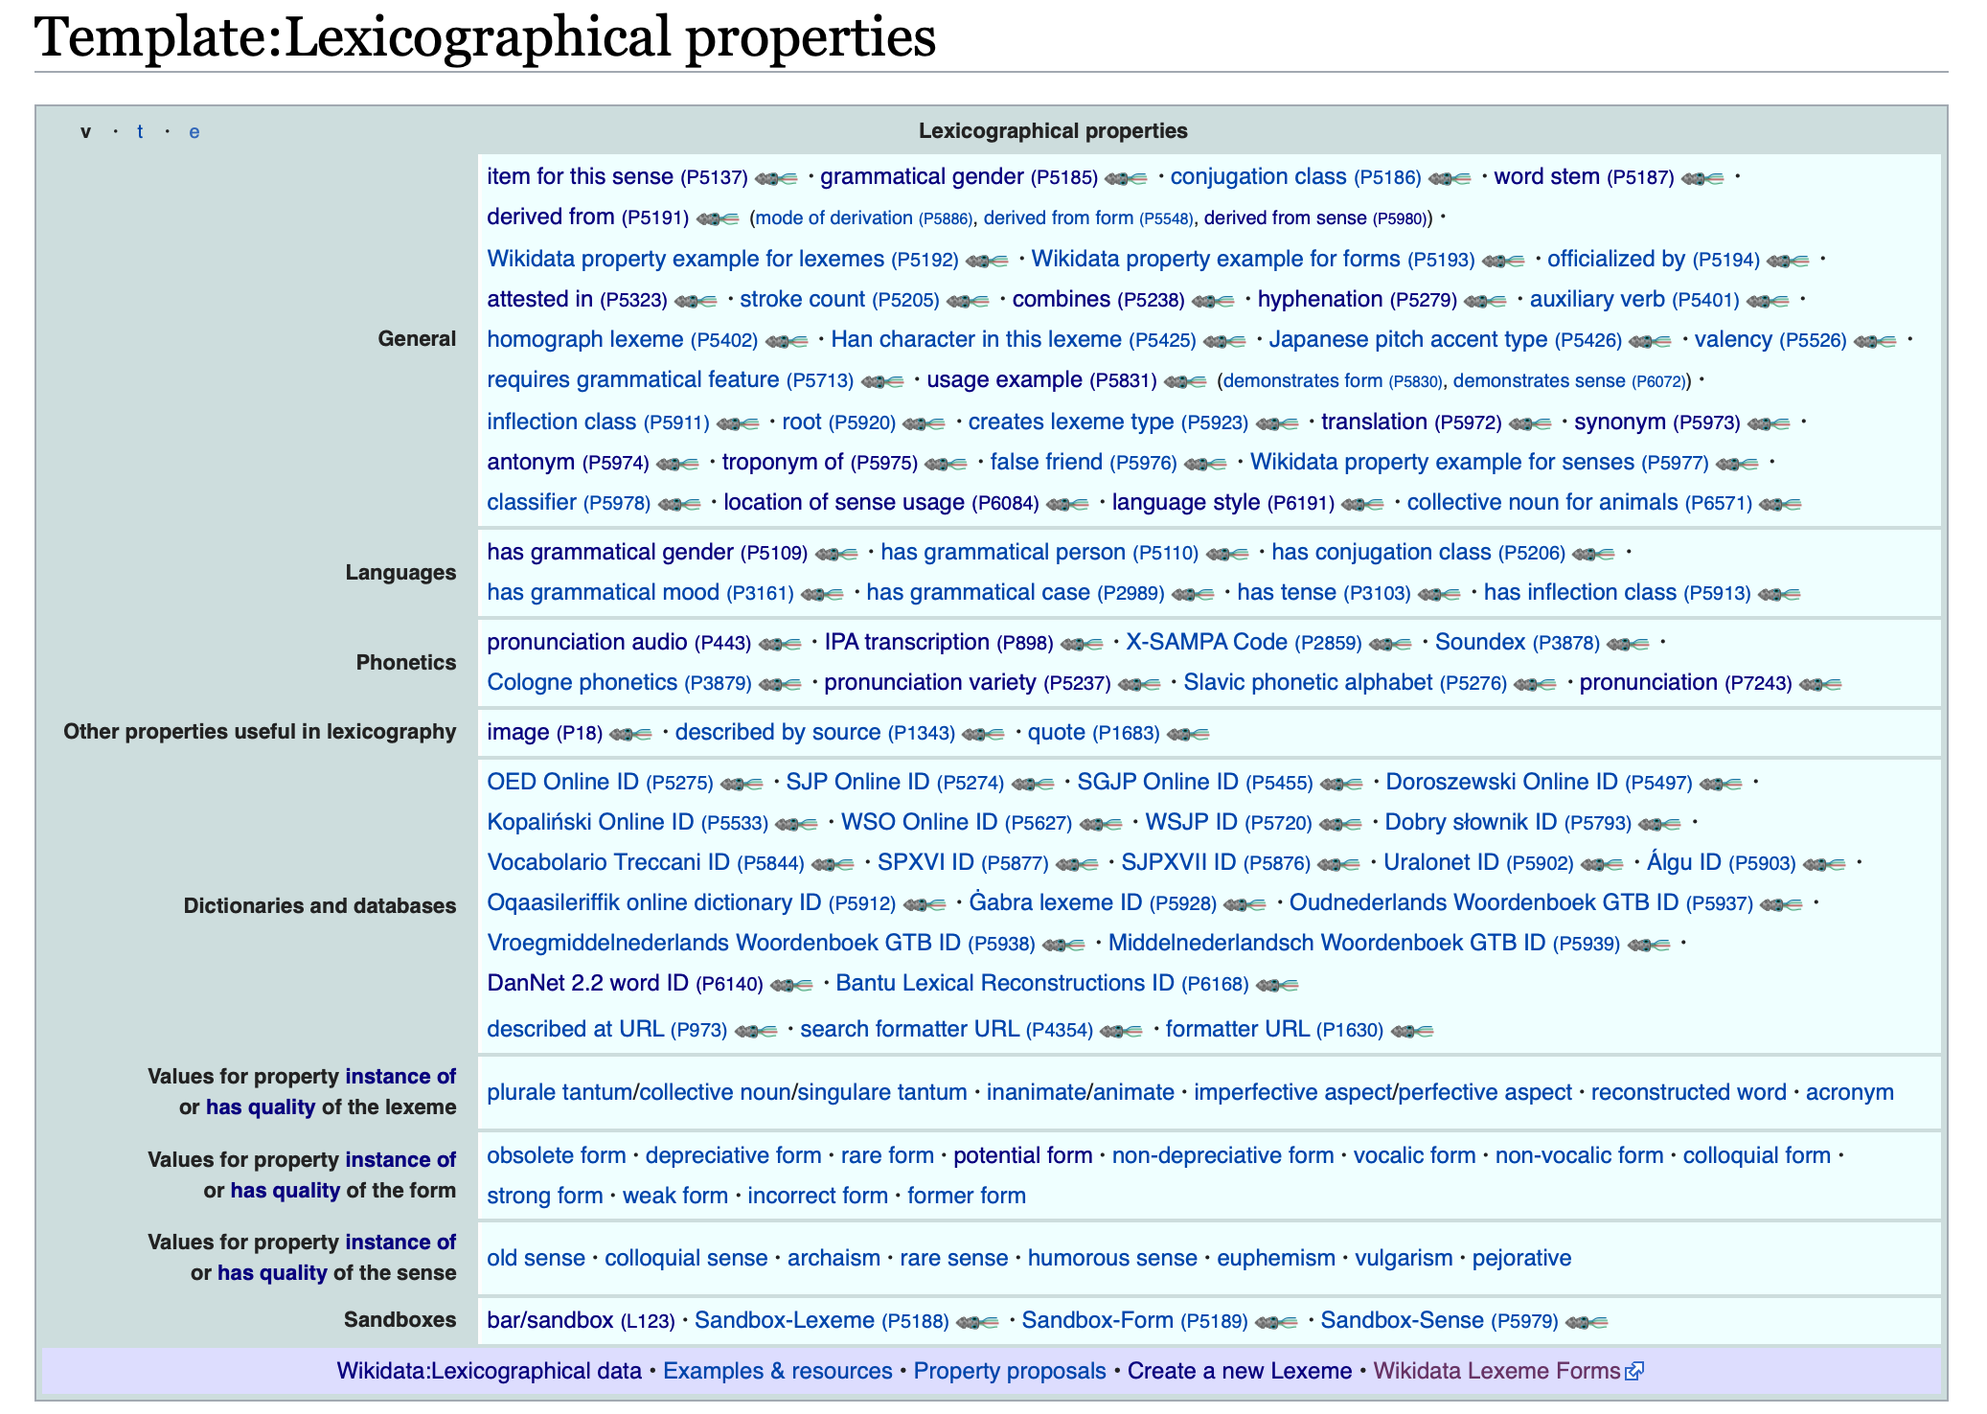

Slide 9
Tools for editing & exploring lexemes
Wikidata Lexeme Forms - https://tools.wmflabs.org/lexeme-forms/
Ordia - https://tools.wmflabs.org/ordia/
Hauki - https://tools.wmflabs.org/hauki/
MacthSinn - https://tools.wmflabs.org/machtsinn/
Wikidata Wordmap - https://esterpantaleo.github.io/wikidata_wordmap/
Others?

Slide 10
Lexeme Bots
November 2018: MewBot (Northern Sami lemmas, lexemes only)
December 2018: Lingua Libre Bot (add pronunciation audio to lexeme forms)
August 2019: YurikBot (Russian lexemes and forms)
August? 2019: Elhuyar Fundazioa bot (Basque lexemes and forms)
October 2019: SixTwoEightBot (English adverbs – lexemes and forms)
October 2019: Uzielbot (Hebrew lexemes and forms)

Slide 11
Workshop Discussion
Review criteria for bots?
Acceptable (CC-0) sources for sense data?
Missing properties?
Anything you hate about the lexicographical namespace? What could be fixed?
Other questions?

